Slide 1
EE16B Prelab Instructions
Form a 2-student team
Find a station to seat (16B stations are 1 - 22)
Download the lab material (course website)
Download the presentation file http://bit.ly/1SDY7oe
Open question&checkoff queue http://bit.ly/1PToyYj
Open the ipynb file and read the instruction
Lab introduction starts at 2:12!!
VERY IMPORTANT: Each team has to have at least 1 MSP from 16A
If not, email gerke@berkeley.edu with subject "Need MSP"

Slide 2
EE16B Lab 1
Session 116
2016. 2. 2
Jaeduk Han

Slide 3

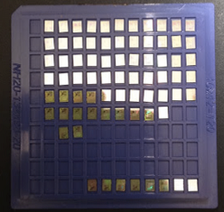
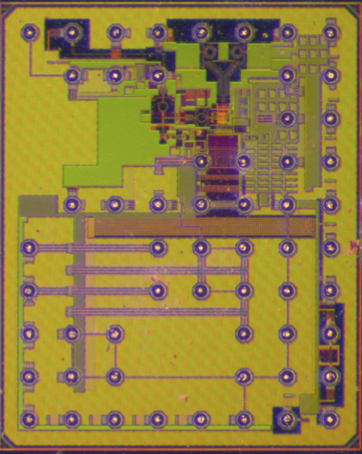
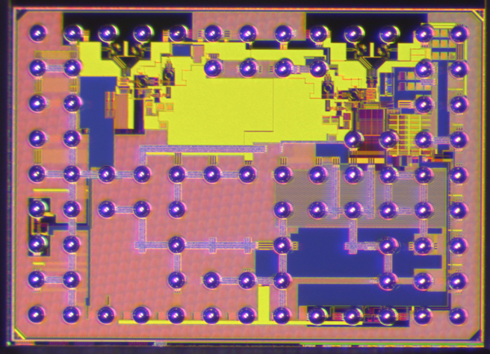
Your Lab GSI
Jaeduk Han
4th year PhD in Elad Alon’s group
Circuit researcher
Communications, power managements, bioelectronics, design automations

Slide 4


Our Great Team!!

Slide 5
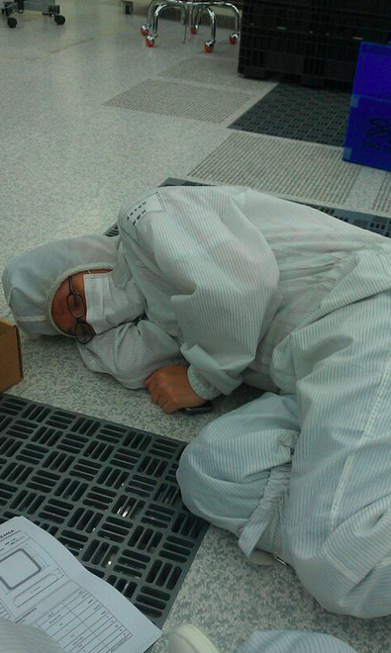
Welcome to EE16B Lab!!
Why do I have to do this!?
Supplements lecture
Gives an opportunity to apply information taught in lecture in a practical way
Gives a glimpse into possibilities in electrical engineering
Helps develop teamwork and people skills
It’s FUN!!

Slide 6
Lab Policies
NO FOOD OR DRINK IN THE LAB!!
Respect the lab equipment
Clean up your work station at the end of lab
Respect your GSI and the Lab Assistants
Be patient with checkoffs; there are 20 groups and two GSI
Clean up starts 5 minute before lab ends
125 Cory is completely booked – other classes need the space
Remember, participation counts toward your grade!
Ask questions
Help your neighbor

Slide 7
Unofficial Suggestions
20-minute rule : BEFORE spending more than 20 minutes on a single problem and making no progress, ask questions
No show? : If you can’t attend a session, please let Alyssa know before the fact
Even after the fact, let us know ASAP
Participation : Please help us & your friends if you finish early
Not showing your answers ☺

Slide 8
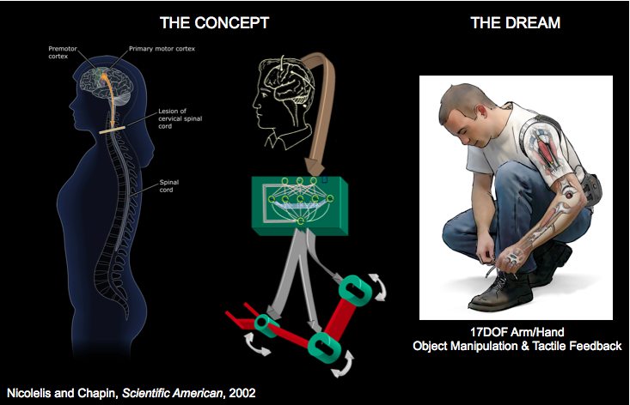


Module 1 BMI
Brain-Machine Interfaces: Motivation
Seamless integration between human brain and
electronics brain

Slide 9

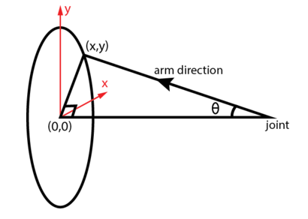
Task1-1: Data preparation
We have (x, y) data
Would like to convert this to Θ
Example: if |x,y|=1, what is corresponding Θ?
*Length=1
*This is a 3-D picture

Slide 10
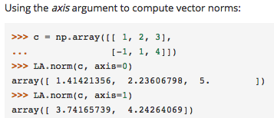
Task1: Data preparation
Angle of a vector = tan⁻¹(|(x,y)|/1)
You should use arctan2

Slide 11
Task1-2: Implementing spike_bins
window_size = 0.1
spike_times
Has 153 lists (=# of neurons)
Each list contains timestamps information of corresponding neuron
spike_data
Dimension: (num_windows, # of neurons)

Slide 12
Task1-2: Implementing spike_bins
Example: spike_times[0]=[0.05, 0.06, 0.25]
spike_data=
2 |  |  |  | …
0 |  |  |  | …
1 |  |  |  | …
0 |  |  |  | …
… | … | … | … | …
window_size=0.1

Slide 13
Task1-2: Implementing spike_bins
Example: spike_times[1]=[0.15, 0.2, 0.25]
spike_data=
2 | 0 |  |  | …
0 | 1 |  |  | …
1 | 2 |  |  | …
0 | 0 |  |  | …
… | … | … | … | …
window_size=0.1

Slide 14
Task1-2: Implementing spike_bins
Question: if window_size is 0.1 and we get a spike of neuron 3 at 1.2s, which bin value has to be increased by 1?

Slide 15
Task2: Least square & sort
Procedure
Build A matrix for least square
Run least square
Sort & pick 20 neurons that have small residual values
How to construct ‘A’?
How to sort?

Slide 16
Task2: Building LS system
Need to do this & solve least square for all neurons,
Find 20 best ones with the smallest residues
10 cols
s0 | s1 | s2 | s3 | s4 | s5 | s6 | s7 | s8 | s9
s1 | s2 | s3 | s4 | s5 | s6 | s7 | s8 | s9 | s10
s2 | s3 | s4 | s5 | s6 | s7 | s8 | s9 | s10 | s11
…
…
…
…
…
a0
a1
a2
…
…
a9
Θ0
Θ1
Θ2
…
…
…
…
…
=
# of time bin rows
s_n=spike_data[n][i]
This is solution; not very important for this task

Slide 17
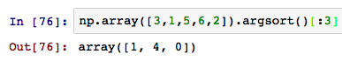
Task2: Least square & sort
Sorting
We need to pick top 20 elements
It’s good to double check the results with GSI or Ais after getting your output
3 | 1 | 5 | 6 | 2
1 | 2 | 3 | 5 | 6

Slide 18
If it took more than 2 hours and you did not finish previous steps, let me know. I’ll help you.

Slide 19
Constructing a new A matrix
Instead of using 153 neurons, we’ll use top 20 neurons
We are making a [(# of angles) x (10*20)] matrix
Each row of A will be
[part of spike_data of the best neuron, part of spike_data of the second-best neuron, …]

Slide 20
Constructing a new A matrix
Need to do this & solve least square for all neurons,
Find 20 best ones with the smallest residues
20*10 cols
sa0 | sa1 | … | sa9 | sb0 | sb1 | … | sb9 | …
sa1 | sa2 | … | sa10 | sb1 | sb2 | … | sb10 | …
sa2 | sa3 | … | sa11 | sb2 | sb3 | … | sb11 | …
…
…
…
…
…
a0
a1
a2
…
…
a199
Θ0
Θ1
Θ2
…
…
…
…
…
=
# of time bin rows
sa = the best neuron, sb= the second best neuron, …
This is our model!! Very important!!

Slide 21
Let’s start!!
PPT http://bit.ly/1SDY7oe
For question & checkoffs http://bit.ly/1PToyYj

